Slide 1
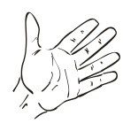
Writing a Science Report
1. Write the name of something you saw at the beach . . . . .
2. Write some words that answer the questions.
What did it look like?
What did it sound like?
What did it smell like?
What did it feel like?
How did it make you feel?
3. Now use some of these words in your writing.

