Slide 1
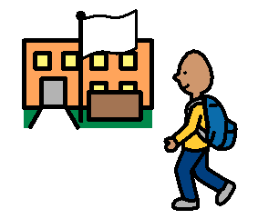
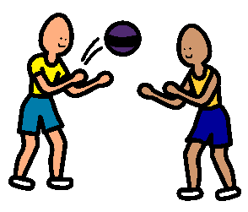
STRANGERS
A stranger is someone you don’t go to school with.
A stranger is someone who you don’t play with in the neighbourhood.

Slide 2
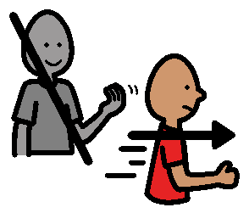
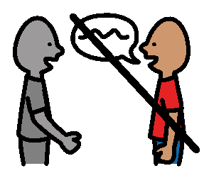
A stranger is a person who isn’t part of your family.
A stranger is not a friend that your parents talk to.
Don’t talk to or go anywhere with strangers.

Slide 3
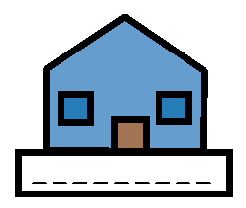
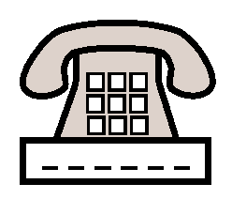
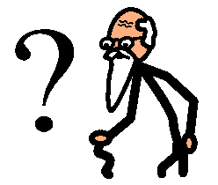
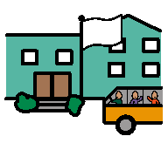
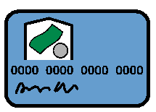
What is Personal Information?
name
address
phone number
birth date
age
school
friend names
card numbers
These should NOT be shared with strangers!!

Slide 4
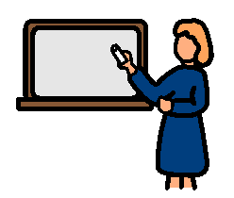
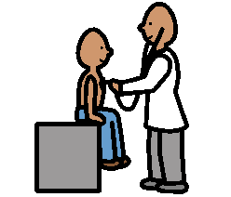
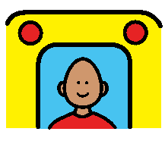
Safe Strangers?
Some strangers are safe to talk to IF you have a problem.
policeman
teacher
doctor
bus driver
fireman
Remember you only need to talk to these strangers IF you have a problem.
Save your stories for your friends.

