Slide 1
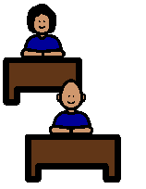
SPEAKING NICELY…
Say something nice!
When I am in the classroom and in the playground….
…I speak nicely to everyone.
If I can’t say something nice I don’t say anything at all!

