Slide 1
Social Skills Posters

Slide 2
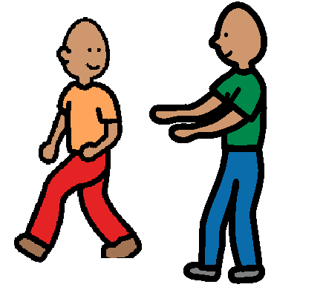
Get your Friend’s Attention
Tap your friend on the shoulder, look at him, and say his name.

Slide 3
Skill 1 – Getting Attention
Explain the rationale
Describe the skill
Look at your friend
Tap their shoulder
Say their name
Demonstrate
The right way
The wrong way
Practice

Slide 4
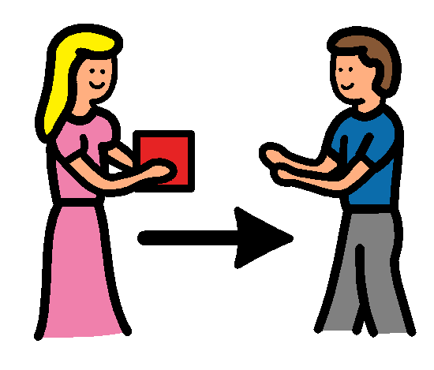
Giving
Get your friend’s attention, say “Here!” Give the toy to your friend.

Slide 5
Skill 2 – Giving
Explain the rationale
Describe the skill
Get your friend’s attention (Look, Tap, Say their name)
Say “Here!”
Give toy to a friend
Demonstrate
The right way
The wrong way
Practice

Slide 6
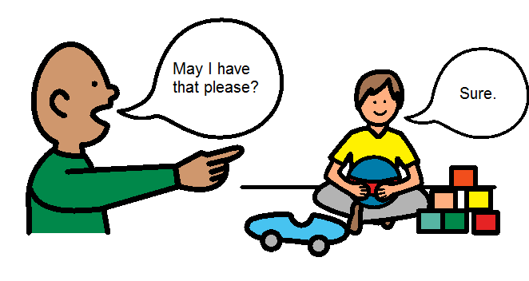
Asking
Get your friend’s attention. Hold out your hand. When you ask for the toy, say “May I have that please”.

Slide 7
Skill 3 – Share Request – “Asking”
Explain the rationale
Describe the skill
Get friend’s attention (Look, Tap, Say their name)
Hold out your hand
Ask for toy (“May I have that please?)
Demonstrate
The right way
The wrong way
Practice

Slide 8
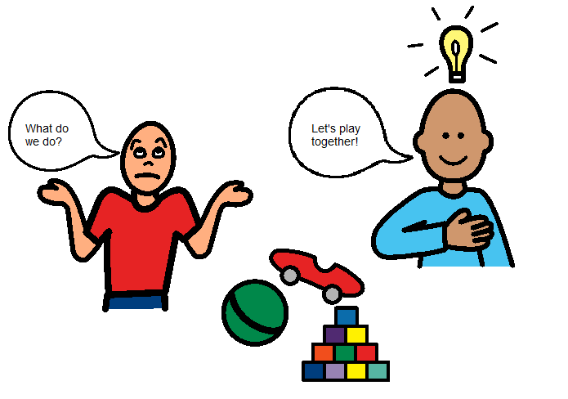
Give a Play Idea
Get your friend’s attention. Give your friend a toy. Give an idea for what to do with the toy or a game.

Slide 9
Skill 4 – Play Organiser “Giving Ideas”
Explain the rationale
Describe the skill
Get friend’s attention
Give friend a toy
Give an idea of what to do with the toy
Give an idea for a play activity or game
Demonstrate
The right way
The wrong way
Practice

Slide 10
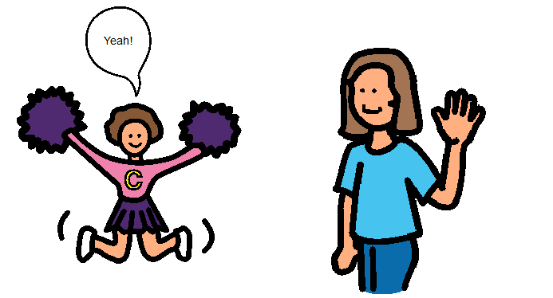
Give a Compliment Outside
Get your friend’s attention. Say, “Way to go!” Give a high-five to your friend.

Slide 11
Give a Compliment Inside
Get your friend’s attention. Say, “Awesome!” or
“You did it!”

Slide 12
Skill 5 – Give a Compliment
Explain the rationale
Describe the skill
Verbal: Say things like “awesome”, “way to go”, “you did it”.
Physical: Do things like high five, pat on the shoulder.
Demonstrate
The right way
The wrong way
Practice

