Slide 1
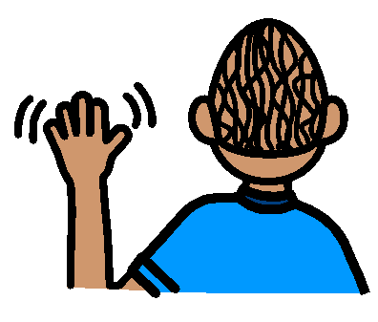
Hi
Bye
How are you?
I’m fine
please
thank you

Slide 2
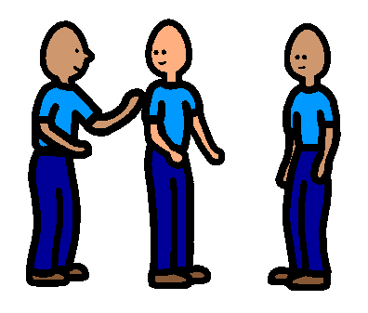
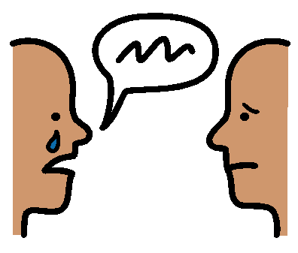
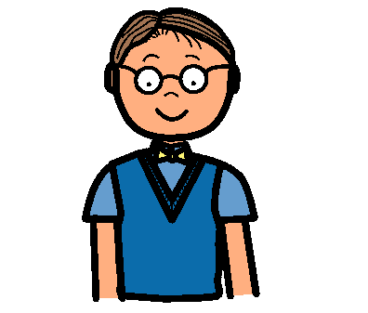
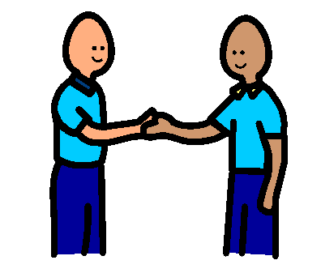
excuse me
sorry
What’s your name?
I’m Jack
Nice to meet you
Can I play?

Slide 3
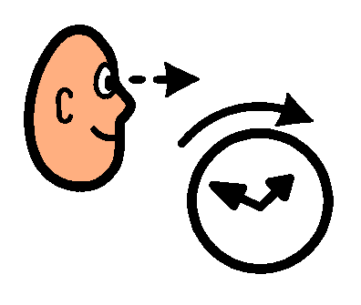
I’m having fun
see you later
What’s new with you?
Guess what?

