Slide 1
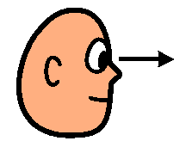
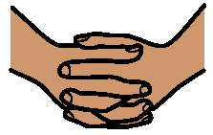
READY TO WORK
Feet on the floor
Look at the teacher
Quiet hands
I’m ready to work

