Slide 1
NEWS TIME – NEWS PLAN
The news plan is a way to teach recounts and descriptions.
A News Plan helps children make the links between what is spoken and what is written. The teacher will need to model how to use the plan to guide news telling.
At first students should be taught how to use the plan as a prompt to guide their news telling. After they are familiar with telling news using the plan they can begin to write the news on the plan. It then can become part of journal writing each week.
Students may need time to build up an understanding of what each WH question means. In kindergarten you many need to start with just Who and What, then gradually introduce the other ideas.
Parents can be involved in drawing up the news plan at home to assist students as well.
The following points should be considered:
Notes and sketches are memory aides – they should be done quickly.
Key words are used on the plan but not necessarily the final written piece.

Slide 2
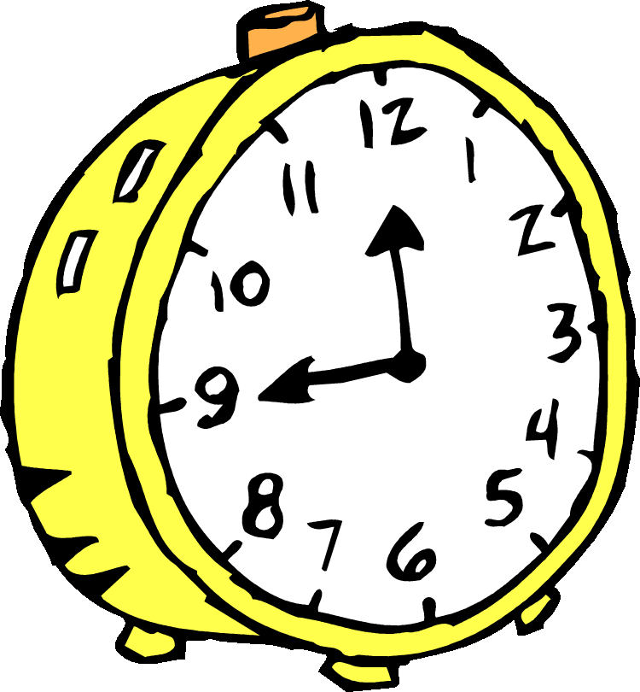
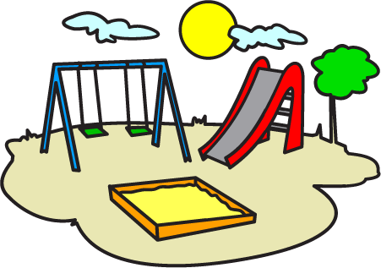
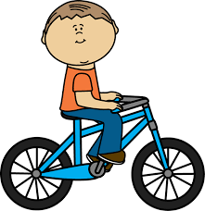
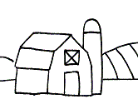
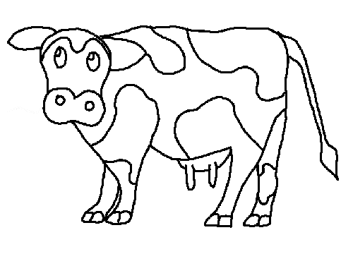
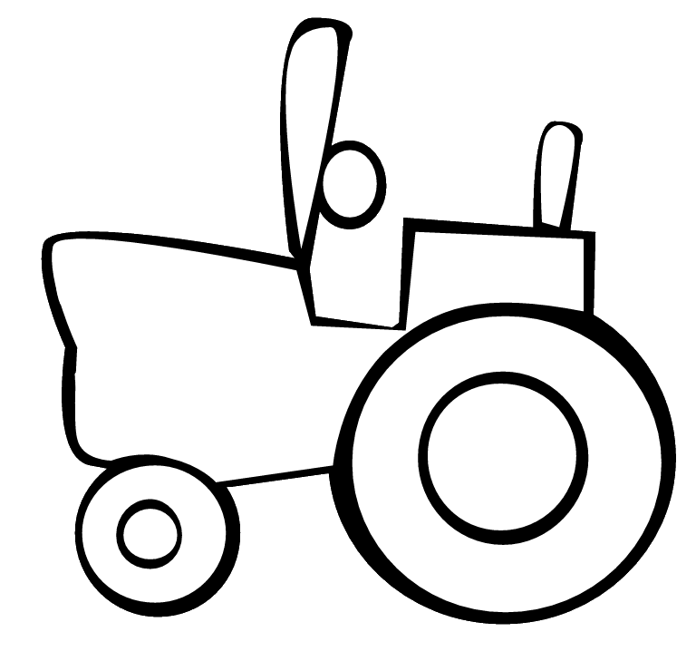
When? | Who? | Where? | What? | Why?
When? | Who? | Where? | What? | Why?
Yesterday my dad and I went to a farm and saw a cow because Pa has a new tractor.

