Slide 1
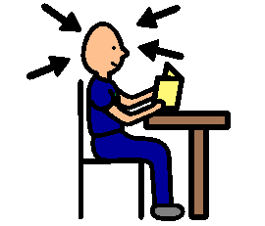
It’s OK to make a mistake.
If I make a mistake on my work it is all right.
Everyone makes mistakes.
After making a mistake I can go back and fix the mistake.
If I make the same mistake again I can go back until I get it right.
Everyone makes mistakes and it’s OK.
That’s how I learn. That’s how others learn too.

