Slide 1
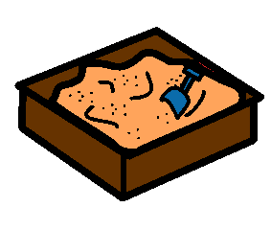
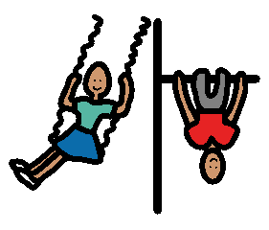
LUNCH TIME
Bell rings
Eat lunch inside
Bell rings
Play outside
You can play
Bell rings, line up.
on the top playground,
on the equipment,
in the sandpit.

