Slide 1
At Gadara School
Insert child’s photo…..

Slide 2
At School

Slide 3
At School

Slide 4
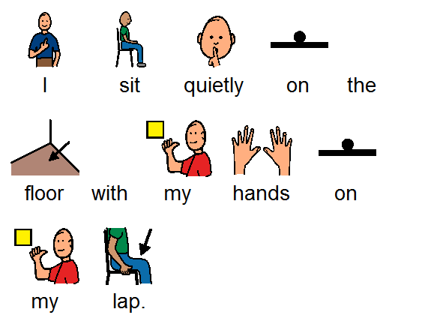
At School

Slide 5
At School

Slide 6
At School

Slide 7
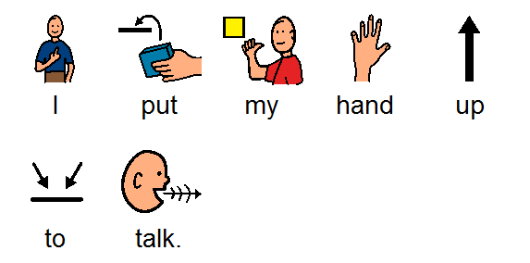
At School

