Slide 1
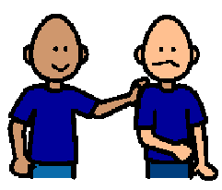
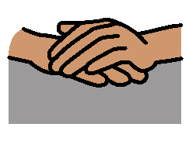
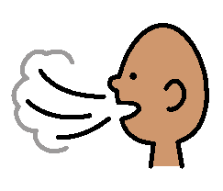
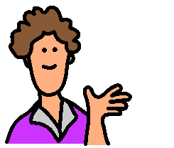
I need to keep my hands to myself
When I feel upset I sometimes put my hands on other people.
When I put my hands on other people, I need to stop.
I need to keep my hands to myself.
I can take 5 big breaths. This will help me to stay calm.
My teacher is happy when I keep my hands to myself.

