Slide 1
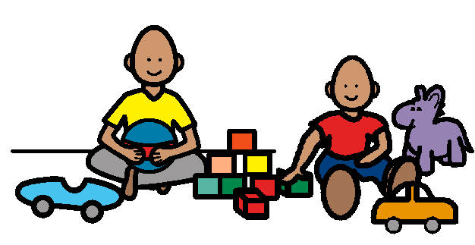
I Want to Play Too!
How to join into play with other children

Slide 2
Sometimes I see other children playing. They are having fun. It is fun to play with kids.

Slide 3
I would like to play with the children. Then I could have fun too.

Slide 4
When I see children playing and I want to play with them, this is what I can do.

Slide 5
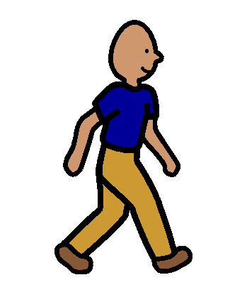
First, I walk over close to them. I don’t go too close. Just close enough so they can see me and I can see what they are doing.

Slide 6
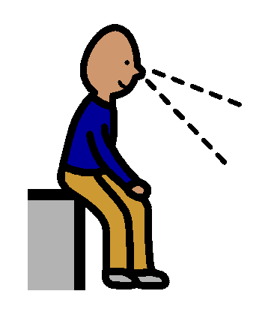
Then, I watch them play for a little bit. That way I know what they are doing and I will know how to play with them.

Slide 7
Next, I say something nice about what they are doing. I might say, “That looks like fun” or “I like those cars!”

Slide 8
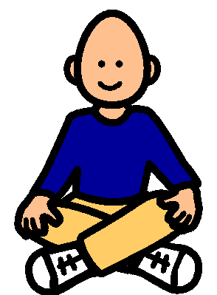
Now I join the children and play with them. It is fun to play.

Slide 9
PLAYING IS FUN When I see children playing and I want to play with them I will……
WALK
WATCH
SAY SOMETHING NICE
PLAY

Slide 10
Information for Teachers and Teaching Assistants.
Students with special needs must be motivated to want to play with other kids. So you have to work with them to make them understand that playing is fun and it is something that they really want to do. Spend some time with your student looking at kids playing. Point out what the kids are doing and keep saying that it looks like fun.
When your student seems to be more motivated to play with others, then read this book so that s/he understands the procedure for joining play. The student should have these steps pretty well committed to memory. You might want to use picture symbols to visually remind your student of the steps.
You will have to coach your student through these steps many times before s/he is ready to join kids playing independently. If things are not progressing smoothly at this point, you might want to set up a play group and have your students practice following the steps to join this play group. You might have to do this many times before your students is ready to try joining an actual group of kids playing in the classroom or playground.
You might need to act our examples and non examples of following the steps. You could do this by setting up a play group and then pretending you are a student trying to join the group. You make mistakes and have the student and the other kids tell what you are doing wrong. For example, you might just rush over and sit down with the group instead of following the steps. Then ask the kids what you did wrong. Or you might stand a long way from the group and watch them. Then you and your student can practice joining the group by following the steps properly.
After your student joins the group, you will have to teach your student that he has to stay and play for awhile. Many of these students are used to fitting around from one activity to another and need to be taught that they have to stay and play.

Slide 11
This book was written by Linda Callilou and is based on material presented at the BCASPL conference in November 2000 by Karen Bopp and Joanne Marshall

