Slide 1
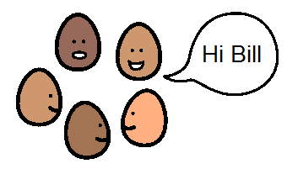
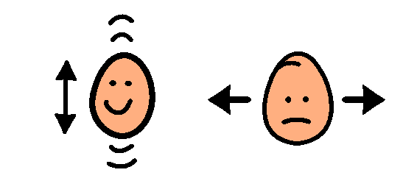
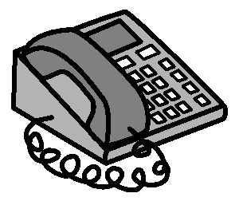
My name is Billy Smith
My mum’s name is Martha
Phone
987 6543
My friends call me Bill.
My dad’s name is Barry.
Phone
987 6543
My address is:
123 Happy Road, Happy Town
When you talk to me ask me yes and no questions.
My phone number is:
123 4567
I need help please.

Slide 2
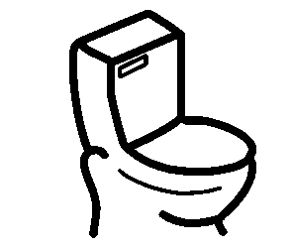
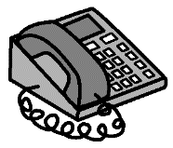
I have trouble telling you what my problem is. Can you call my mum or dad please?
I need a toilet.
My birthday is:
25th December, 2000.
25/12/2000
My doctor is Dr Dolittle
Phone
987 6543

