Slide 1
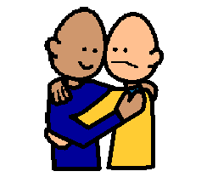
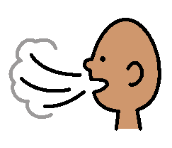
Hugs and Kisses
When I feel upset I sometimes hug and kiss people at school.
I can hug and kiss my family, NOT people at school.
When I hug and kiss people at school, I need to STOP.
I can take 5 big breaths. This will help me to stay calm.
My teacher is happy when I do not hug and kiss at school.

