Slide 1
HOME SCHOOL DIARY
A home school diary can be set up to provide students with a way to talk about their days. It can be used for:
Telling news at school.
Telling family members what happened at school.
Telling peers and teachers what happened on the weekend.
USING A HOME SCHOOL DIARY
Decide on a format. A home school diary could be as simple as a plastic sleeve with a remnant or picture in it, or as elaborate as a series of symbols that students can select or circle. Inexpensive photo albums are a great format for a chat book.
Provide students with an opportunity to display their home school diaries, eg,
During news
When greeting the students in the morning
At recess or lunch time, so they can decide when they want to ‘talk’.
Provide positive feedback when students use the diary. Listen, make eye contact, make appropriate comments, and extend the interaction by asking simple questions. Make using the home school diary a positive and rewarding experience.
The home school diary encourages students to choose which part of the day they want to tell their family about, and also encourages them to make a comment about how much they enjoyed it. The choice cards could be copies of the symbols used on the student’s timetable.
Today I did….
It was….
painting
reading
bubbles
maths
fun
not fun
velcro dot

Slide 2
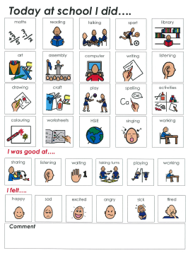
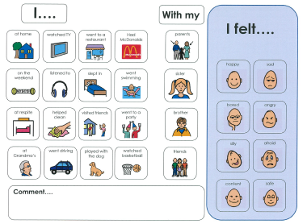
The home school diary below could be laminated so that students can circle the relevant activities each day. It also includes a space for a written comment such as “I liked painting a picture”. The back of the diary may feature a range of symbols representing activities that students often do on the weekend, that he can circle to bring news from home.
FRONT (about school)
BACK (about home)

