Slide 1
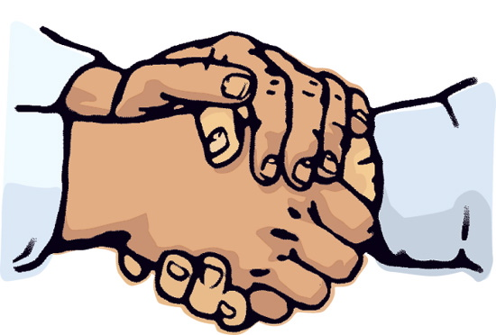
Good Touching

Slide 2
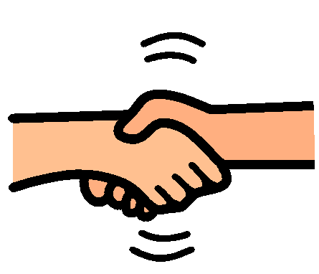
There are different kinds of touching.
Shaking hands is good touching.

Slide 3
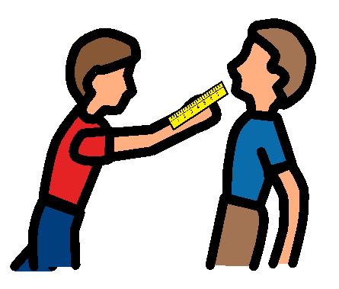
Some touching is bad because it could hurt your friends.
Hitting people with things like a ruler is bad.

Slide 4
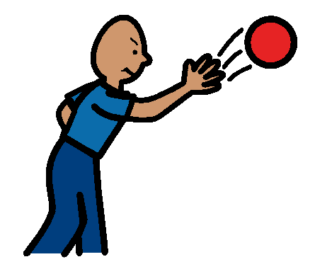
Throwing things at people is bad because it could hurt them.

Slide 5
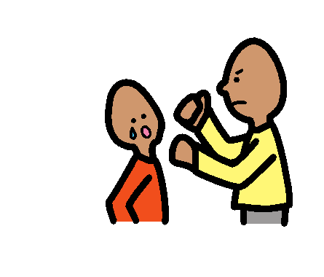
Hitting or punching people is bad too, because you could hurt them.

Slide 6
Putting your hands around someone’s neck is very bad because you could hurt them very badly.

Slide 7
When you hurt people, they get sad and feel cranky with you.

Slide 8
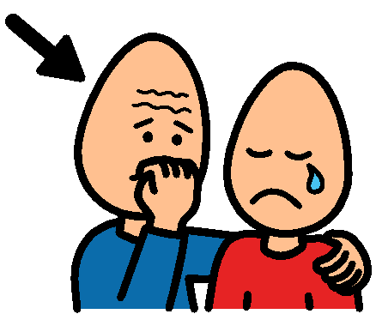
When you hurt someone, you need to say sorry to them.

Slide 9
If you hurt people, you will not be allowed to do fun things, like play the computer.

Slide 10
When people tell you to STOP you must STOP.

Slide 11
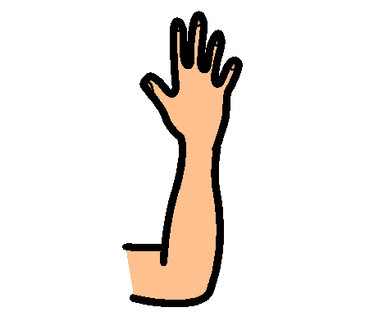
But there are lots of good ways you can touch people. You can “Hi Five” people.

Slide 12
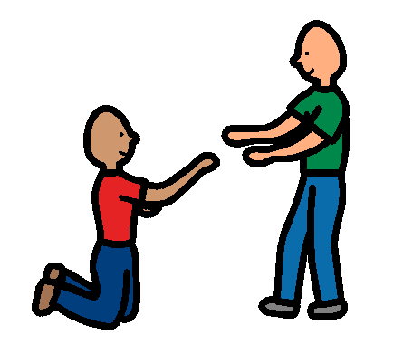
You can help people when they fall over or have an accident.

Slide 13
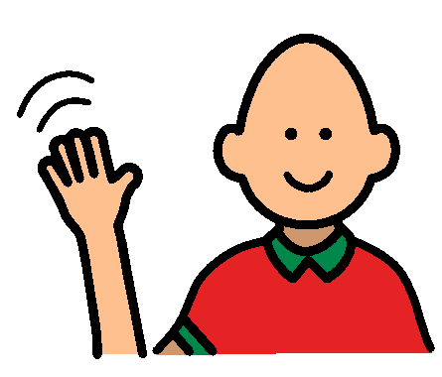
You can wave to someone and smile at them. This means you like them and they like you. This is what friends do.

Slide 14
Your friends do not like it when you hurt them or stop them learning.

Slide 15
When you do the right thing and stop hurting people and stop interrupting their learning then you are happy because you get time on the computer.

Slide 16
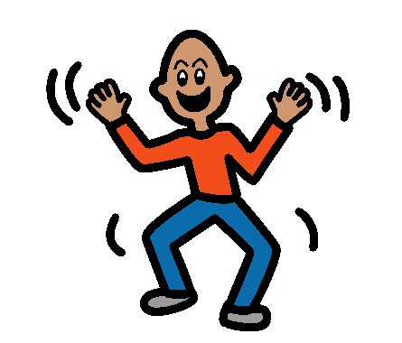
And all your friends and classmates are happy.

Slide 17
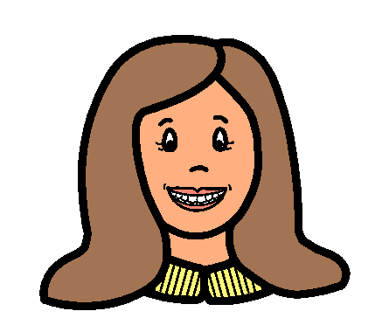
All your teachers are happy too.

