Slide 1
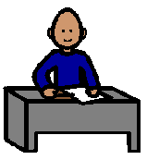
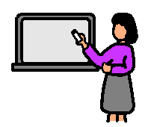
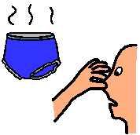
Tom’s Contract
During each session Tom MUST:
MORNING:
Complete his work
Follow teacher’s instructions
Stay clean, but if dirty clean himself up
Be polite to everyone
MIDDLE:
Complete his work
Follow teacher’s instructions
Stay clean but if dirty clean himself up
Be polite to everyone
AFTERNOON:
Complete his work
Follow teacher’s instructions
Stay clean but if dirty clean himself up
Be polite to everyone
If Tom does this he will get 10 minutes YouTube at the end of the day.
Signed Mrs Skein______________________ Tom_______________________

