Slide 1
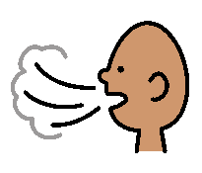
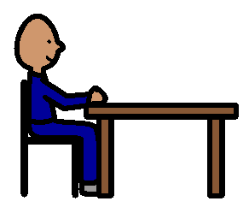
Calm Down
Take a deep breath
Count to 5
4
5
Rest in my chair.

