Slide 1
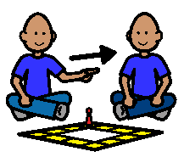
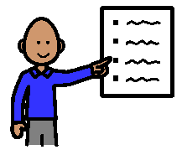
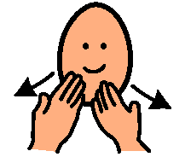
BEING A GOOD SPORT
BEING A GOOD SPORT
When I play games I take turns.
I keep the rules.
If I win I say “Thank you!”
If I lose I say, “well done”. I don’t scream or cry or be a sore loser.
When I am a good sport people like to play with me and my teachers are happy.

