Slide 1
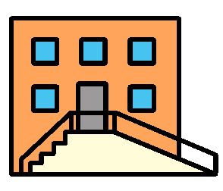
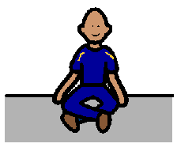
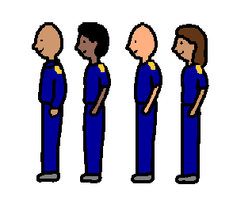
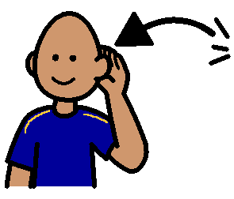
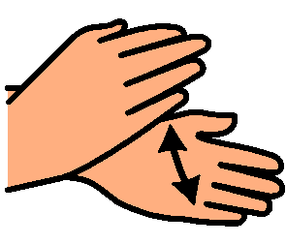
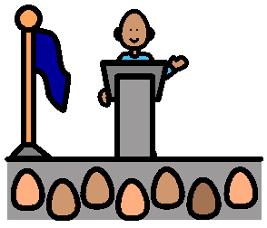
ASSEMBLY
The bell rings for Assembly.
We line up and walk to the hall.
We sit in the hall with our class.
We listen to the people who talk at Assembly.
We clap when children get awards.
We listen to the Principal.

Slide 2
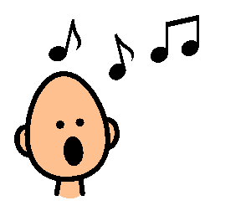
We sing the National Anthem.
Our teacher tells us well done and takes us back to get our lunch.
We are happy.

