Slide 1
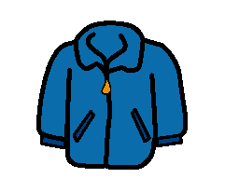
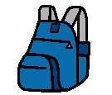
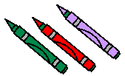
Coming to school
Ready to work
coat on hook
take out pencil
hang up backpack
take out crayons
take out lunch
take out scissors
Put lunch away
take out glue

