Slide 1
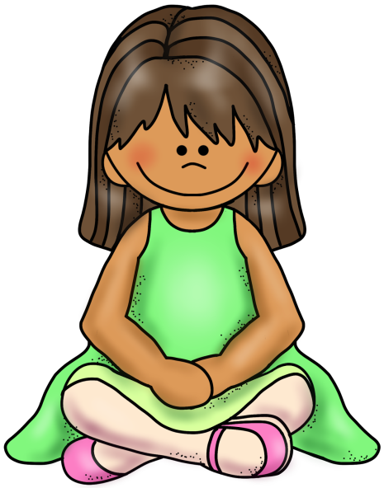
When I listen, I
Look at the speaker.
Keep my hands in my lap.
Stay in my place.
Think of questions to ask.

Slide 2
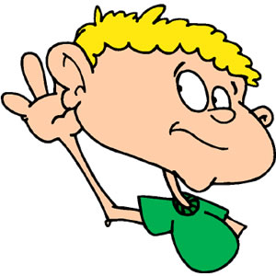
Am I a good listener?
Do I like to listen to my friends when they talk to me?
Do I try to understand what people are saying?
Do I give my teacher my full attention?
Do I ask question to have speakers explain their ideas?

