Slide 1
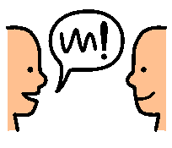
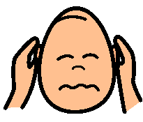
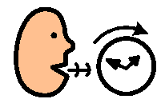
When I speak to the class for News
I will always make my body interested in what I am saying.
I will look at people I am talking to.
I will always talk in a way that is friendly.
I will only speak in my classroom voice.
I will not talk too fast.
I will speak in sentences.
I will listen to people asking me questions.
I will answer people’s questions.

