Slide 1
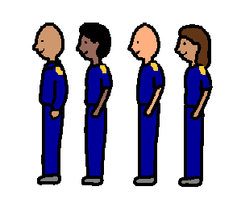
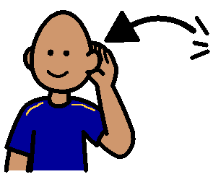
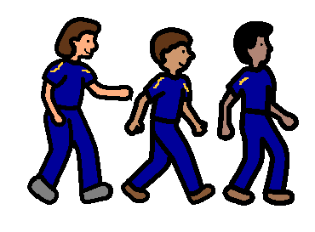
WHEN DO I LINE UP?
1
2
3
In the morning I line up with kindergarten on the cement area.
When I am at school I need to line up.
The bell tells me when to line up.
4
5
6
My teacher tells me to walk in line to the classroom.
I listen to the teachers.
At the end of recess I line up with my class.

