Slide 1
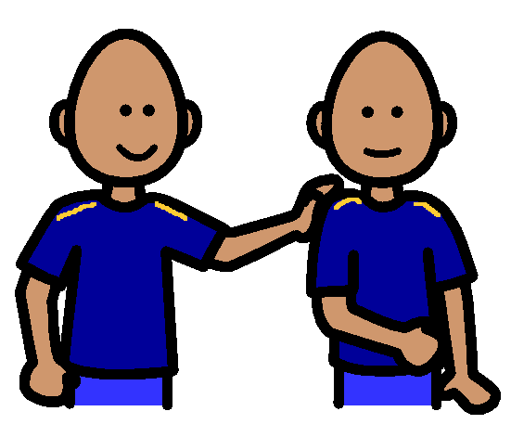
Touching Others

Slide 2
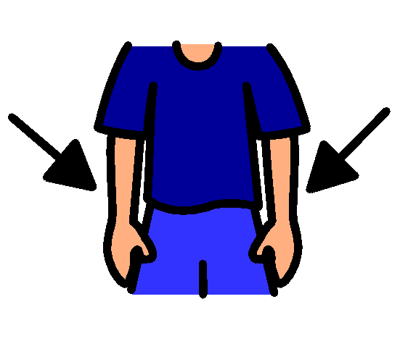
I love talking to my friends and teachers, but when I do, I always keep my hands by my side.

Slide 3
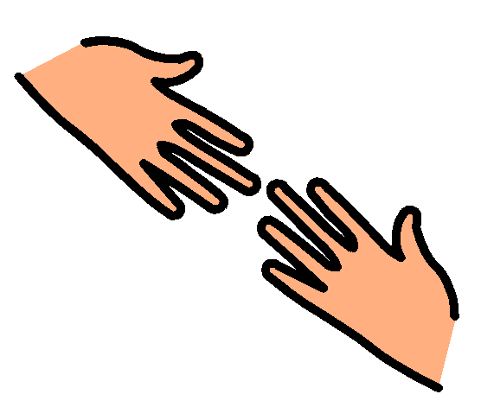
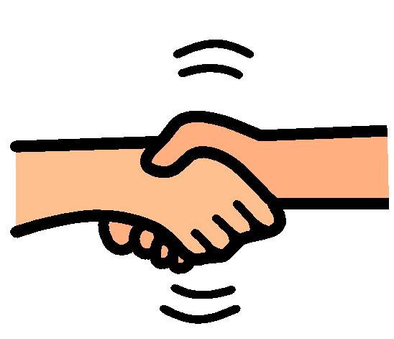
Sometimes I might touch my friends or teachers to shake their hand or to help them if they are hurt.

Slide 4
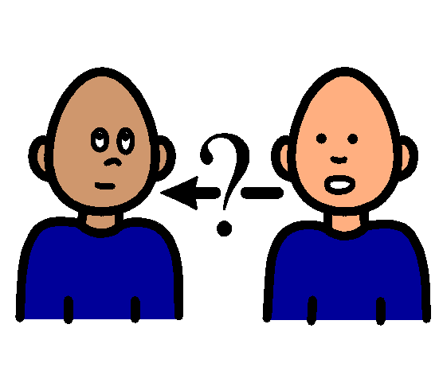
I must always remember to ask permission before I touch someone.

Slide 5
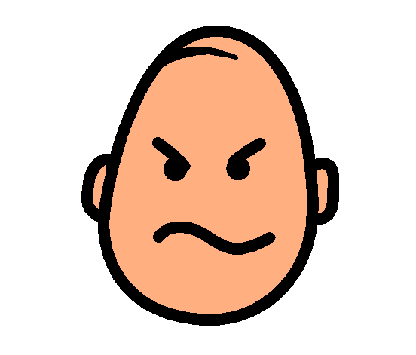
I would not like it if someone touched me when I didn’t want to be touched.

Slide 6
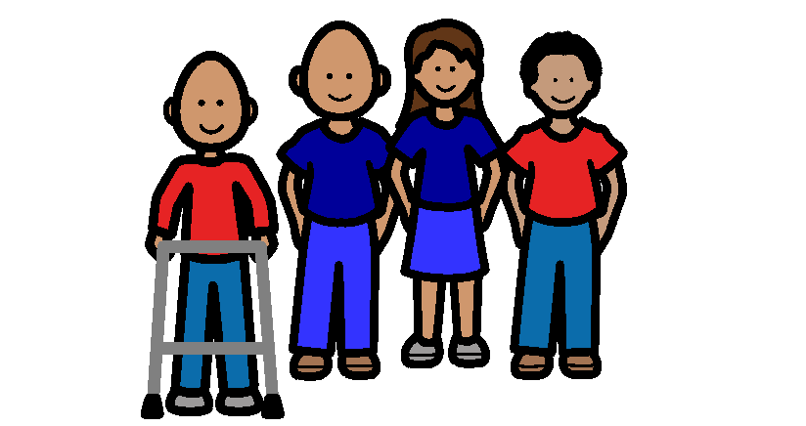
I have lots of friends because I always keep my hands to myself.

