Slide 1
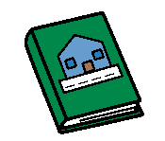
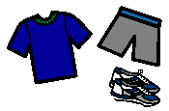
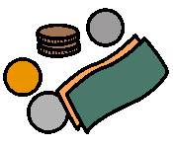
Things Tamara needs for school
Things Tamara needs for school
Home Reader
Home Reader
Signed note
Signed note
Sport clothes
Sport clothes
Money
Money
Library bag
Library bag

