Slide 1
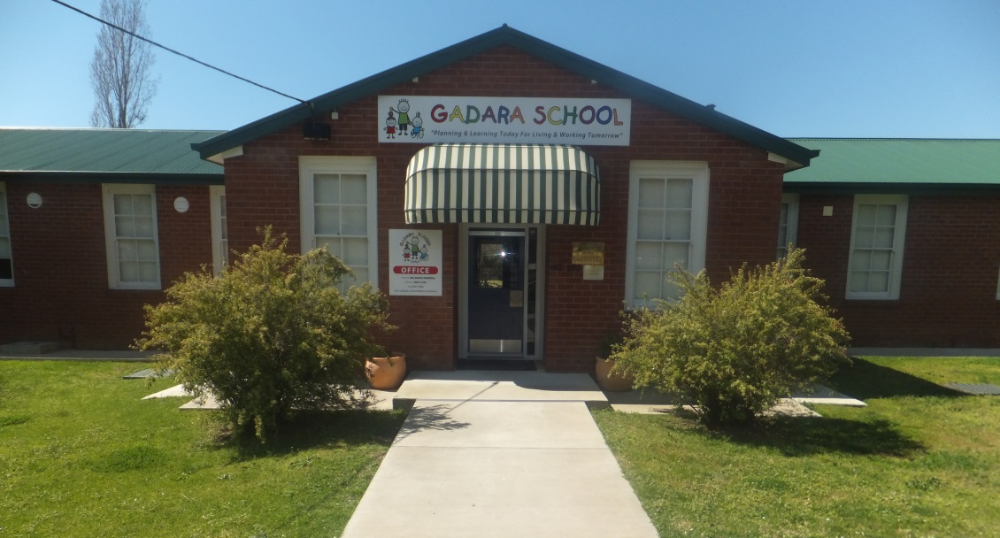
My School
My name is Molly
This is a story about my school
GADARA SCHOOL

Slide 2
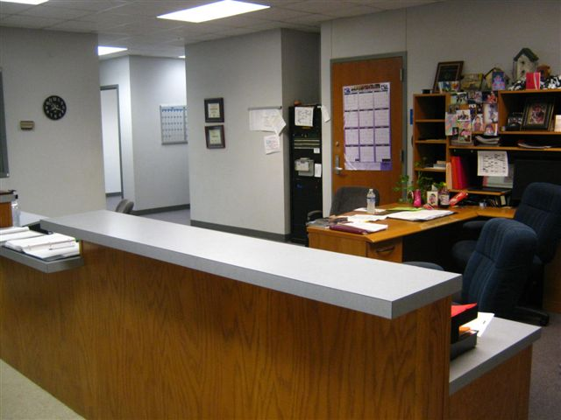
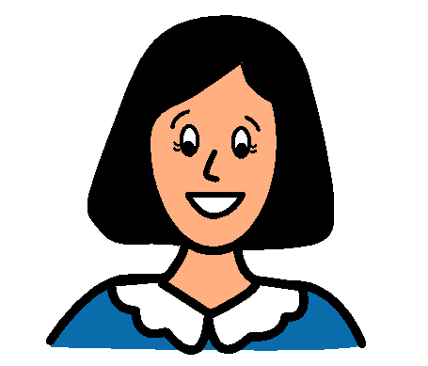
This is the school office.
Messages and notes are brought here.
Mrs Peel is the office lady.

Slide 3
Mrs Kingwill is the principal of Gadara School.
This is Mrs Kingwill’s office. It is next to the school office.

Slide 4
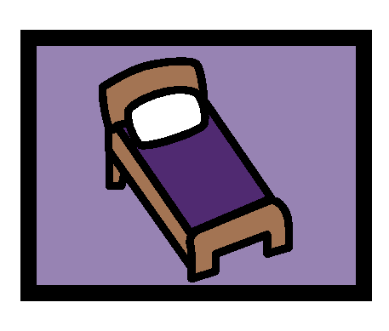
This is the sick bay.
I may go in here if I am sick at school. Mrs Peel will call mum to come and get me.

Slide 5
We have a library at Gadara School.
I can read books in the library.

Slide 6
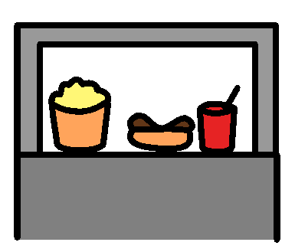
This is the school canteen.
Sometimes I can buy food at the canteen for recess or lunch.

Slide 7
The bell rings to go into class.
The bell rings to go out to recess and lunch.
The bell rings to go home.

Slide 8
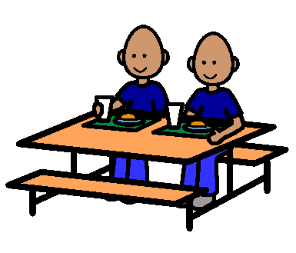
This is where I eat my recess and lunch and I sit here until I have finished.

Slide 9
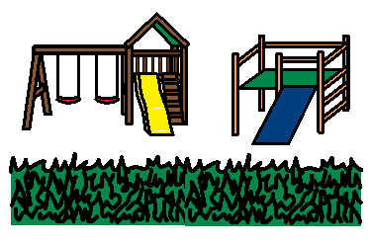
This is the undercover play area.
This is the bottom playground.
It is fun to play in the playground at recess and lunch time with my friends.

Slide 10
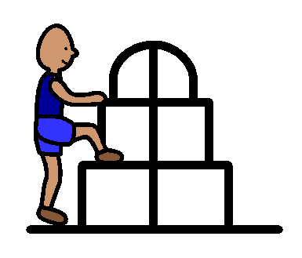
This is climbing equipment.
I can climb on the equipment when a teacher is watching.

Slide 11
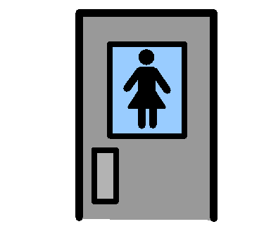
These are the girls’ toilets.
There are toilets for the boys and girls. I will use the girls’ toilets.

Slide 12
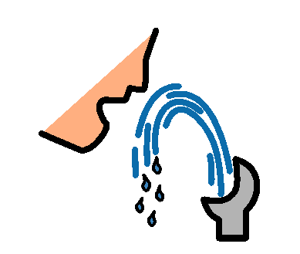
These are the bubblers.
If I am thirsty, I can have a drink from the bubblers in the playground.

Slide 13
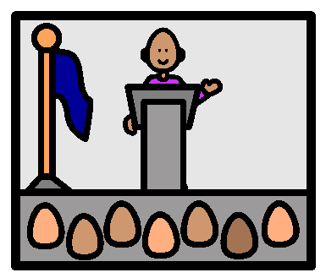
This is where we have assemblies.
I have to sit quietly and listen.

Slide 14
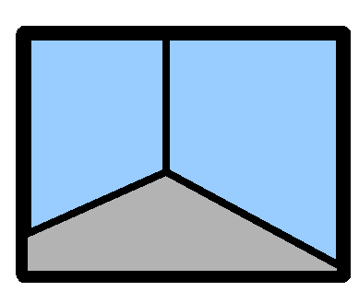
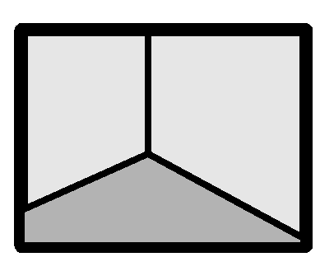
I will be in Year 1 after the holidays.
That means that I will have a new teacher and a new classroom.
This may be my classroom.
Or his may be my classroom.

Slide 15
Mrs Kingwill, the principal, tells the teachers who will be in their classes for next year.
Mrs O’Sullivan will not be teaching Year 1.
I will not be having Mrs O’Sullivan as my teacher when I come back to school.

Slide 16
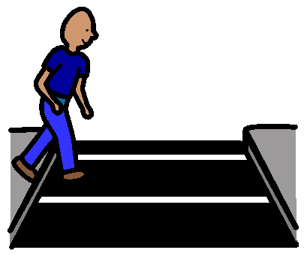
This is the crossing that I will use in the morning and afternoon when I walk to and from school.
The rule is that I have to “walk” on the crossing. There is no running on the crossing.

Slide 17
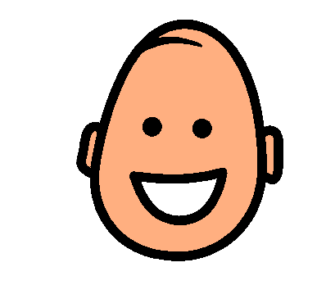
I will be happy to go back to my Gadara school after the holidays.
I will be happy to be in Year 1 with my new teacher and the other children who will be in my class.

