Slide 1
Moving around in the classroom

Slide 2
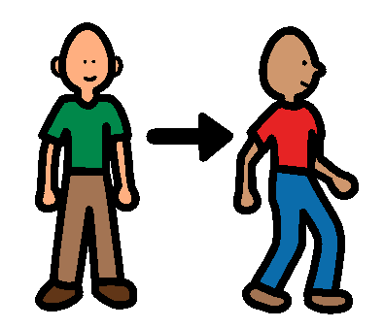
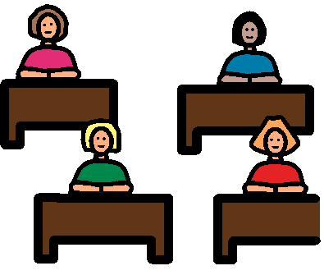
I usually sit down to work in my classroom. Sometimes I have to stand up and move around.

Slide 3
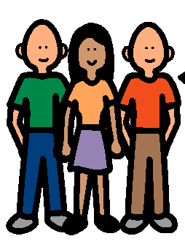
There are lots of people in my class. There is a lot of furniture in my classroom too. I have to look around me carefully before I move. I do not want to bump into anyone.

Slide 4
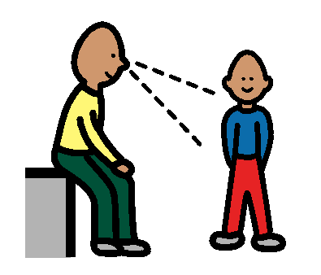
Before I stand up. I look around to see if anyone is standing close to me. If someone is close to me and I might bump into them, I use my inside voice to say, “Excuse me, can you please move?” I will stand up when I can see that I will not bump into anybody.

Slide 5
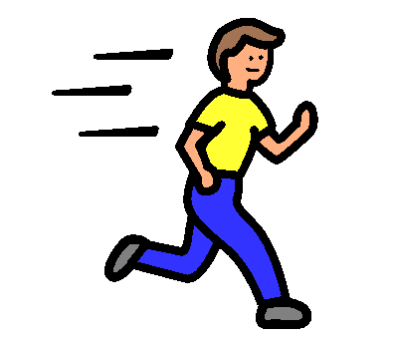
I CANNOT move quickly in my classroom. It is too crowded. If I move quickly I might have an accident. I don’t want to get hurt. I don’t want to hurt anyone else in my class.

Slide 6
When I walk, I keep my head up and I look around me so I know what is close to me. I move slowly. If somebody is getting close to me I stop moving. I use my inside voice to say, “Excuse me please, I need to get past you”. I wait until there is enough room for me to get past before I start moving.

Slide 7
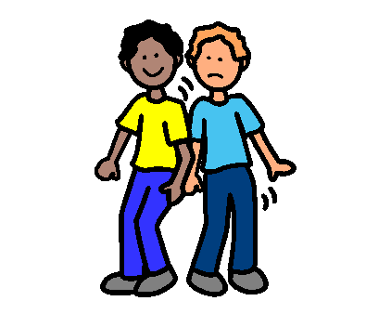
If I have an accident and bump into somebody I STOP. I use my inside voice to say “I’m sorry”. Before I move again I think quietly to myself, “Keep my head up. Look carefully all around. Move slowly”.
I’m sorry

Slide 8
I like it when people look carefully and move slowly so they don’t bump into me. Other people will like it if I look carefully and move slowly so they don’t get hurt.

Slide 9
Everybody will be happy if we look out for each other and move slowly in our classroom.

