Slide 1
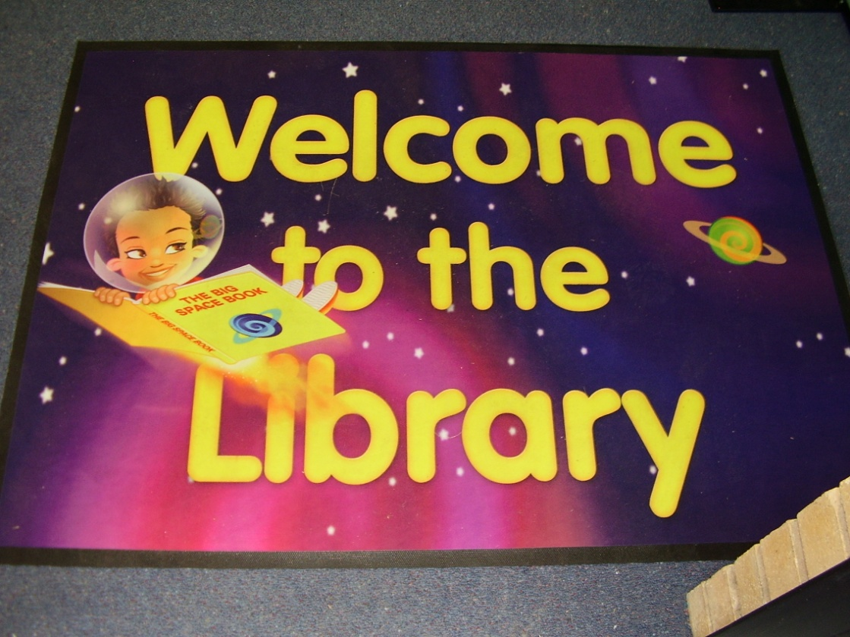
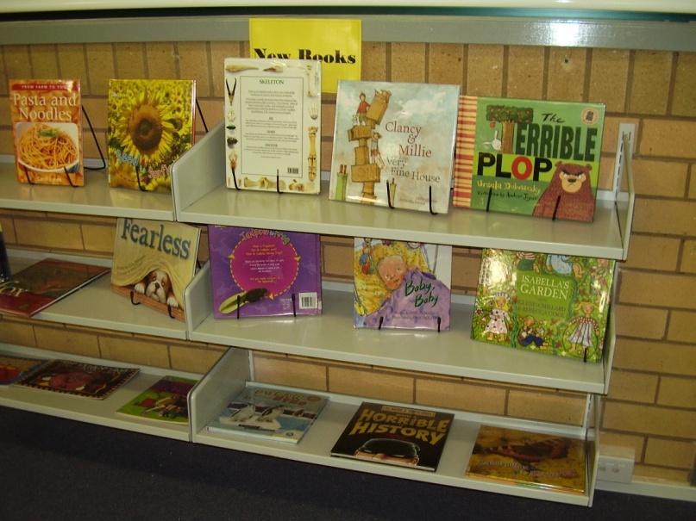
Library Day

Slide 2
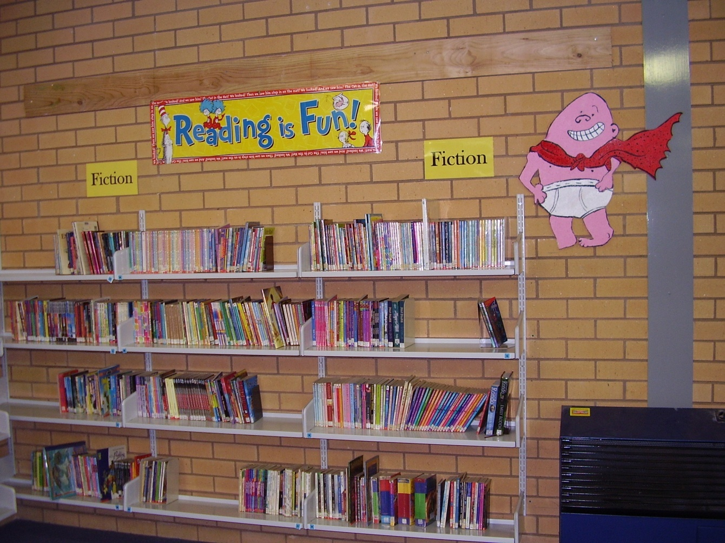
On Tuesdays Sarah goes to the library.

Slide 3
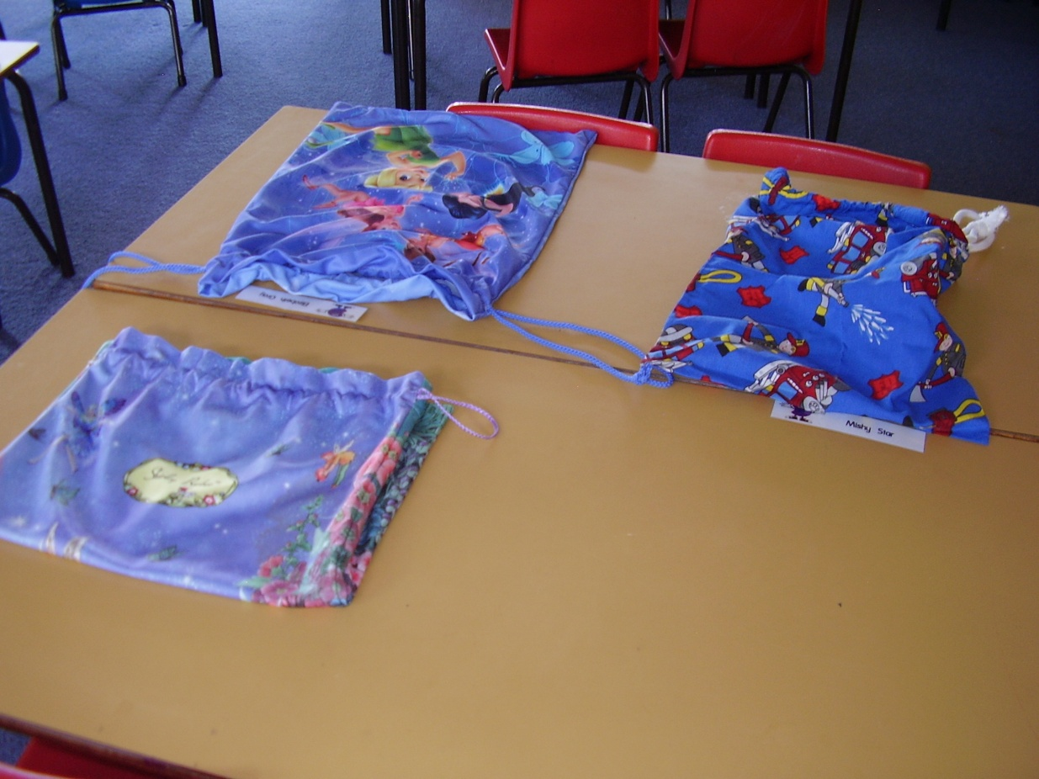
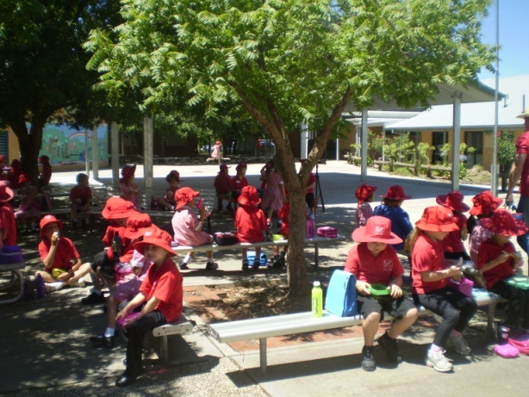
Sarah will leave her library bag on her desk when she goes to lunch.

Slide 4
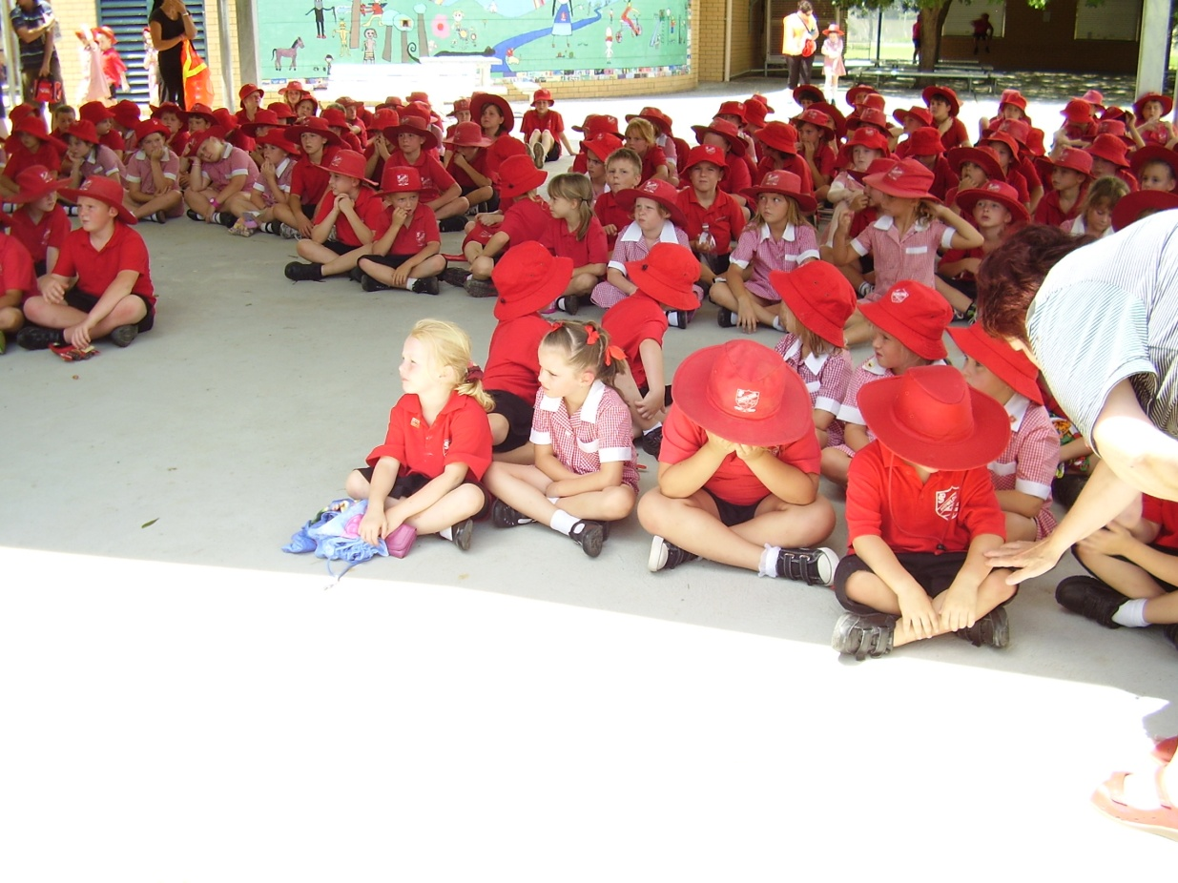
After lunch Sarah will line up at the assembly area.

Slide 5
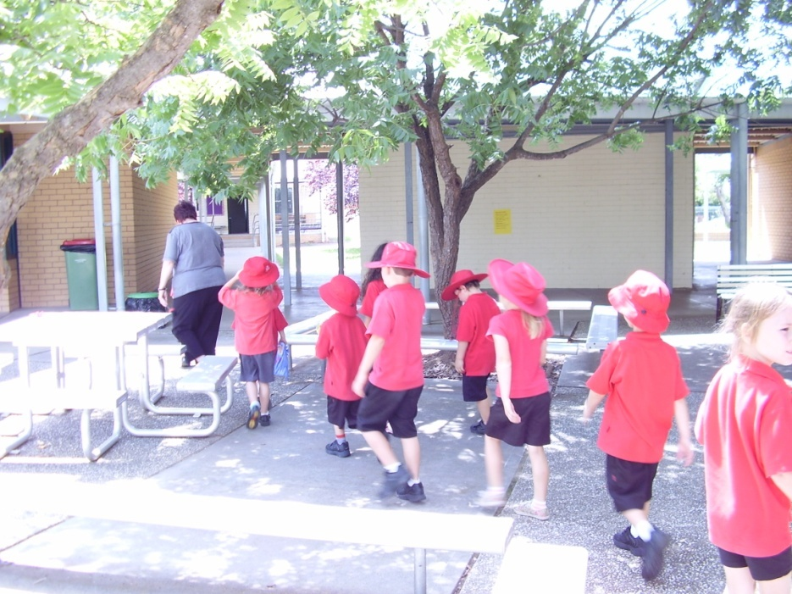
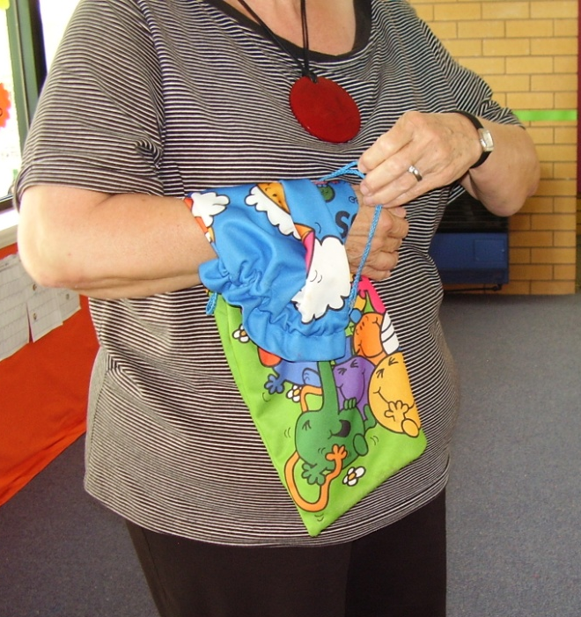
Mrs Mac will take the class back to the classroom to get their library bags. Sarah will carry her library bag and walk in line to the library.

Slide 6
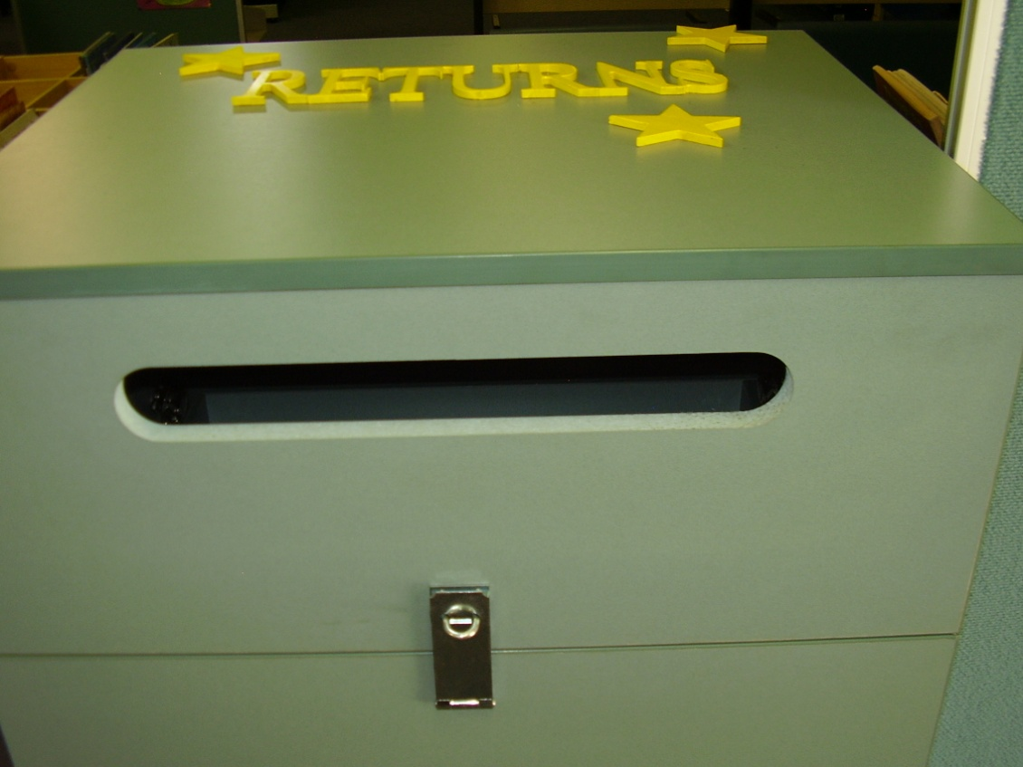
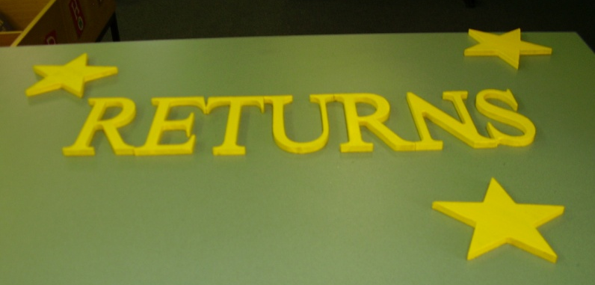
Sarah will take her library book out of her library bag and put it in the returns box.

Slide 7
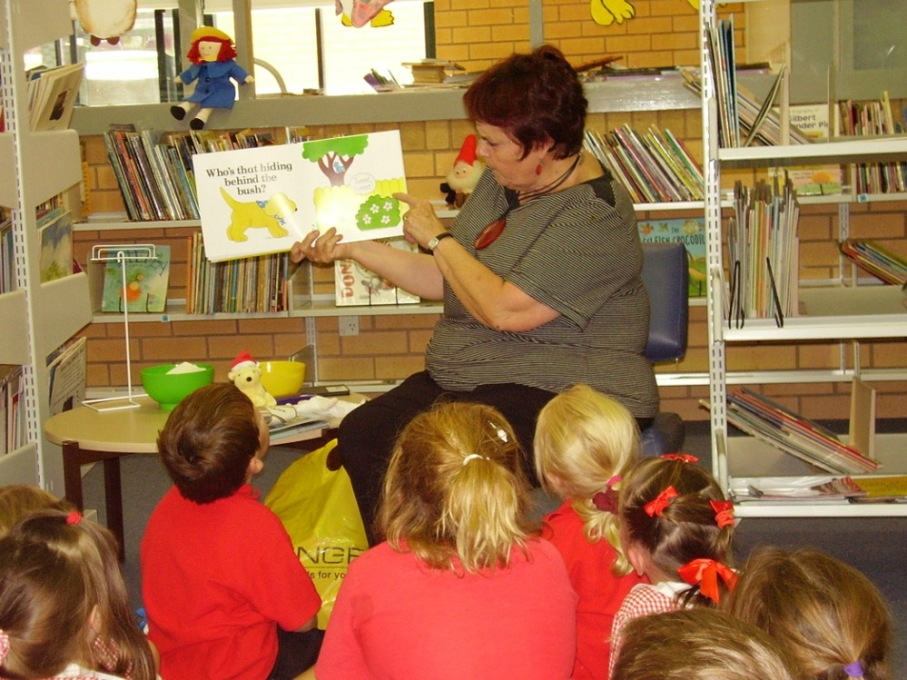
Mrs Mac will read a story. Sarah will sit and listen to the story.

Slide 8
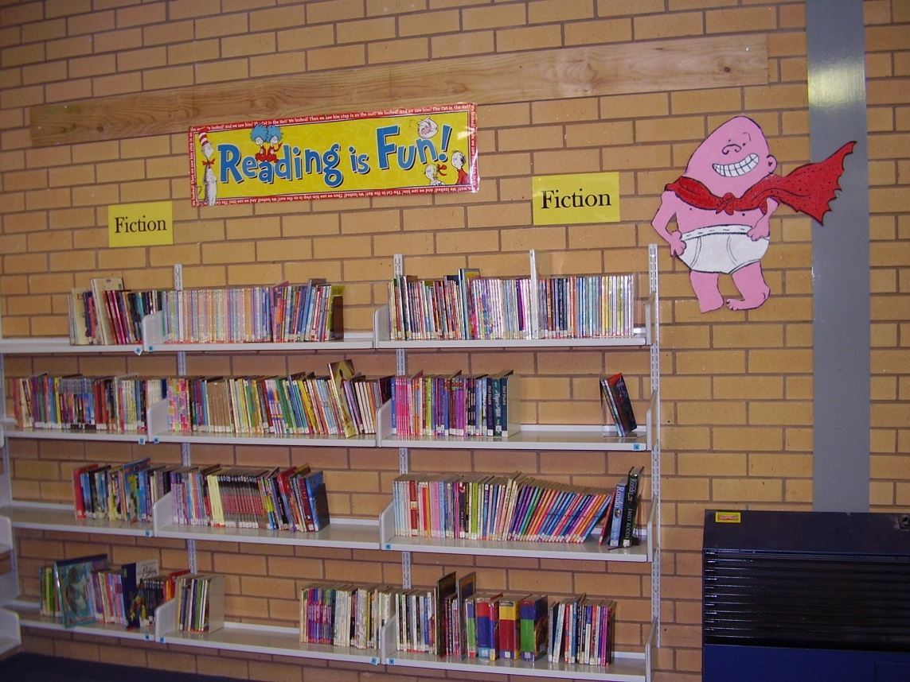
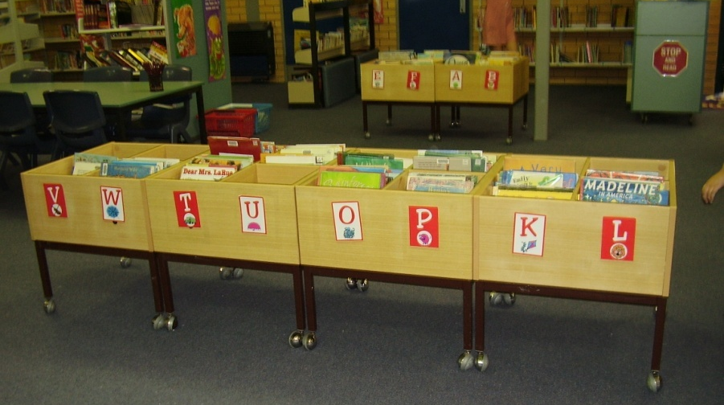
Sarah will choose a book to take home.

Slide 9
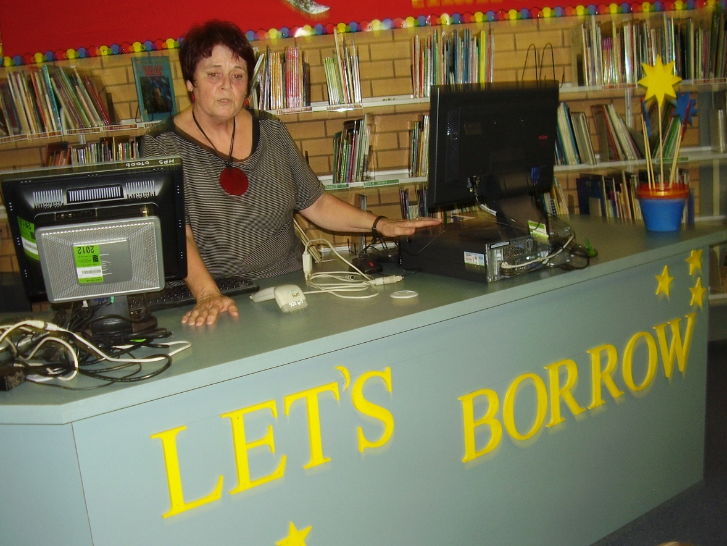
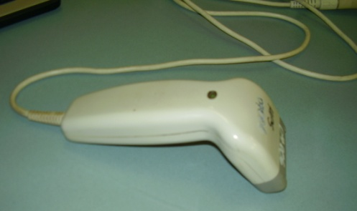
When Sarah has picked a book she lines up at the borrowing counter. Mrs Mac will use a wand to scan the book.

Slide 10
Mrs Mac will give the book back to Sarah and she puts it in her library bag.

Slide 11
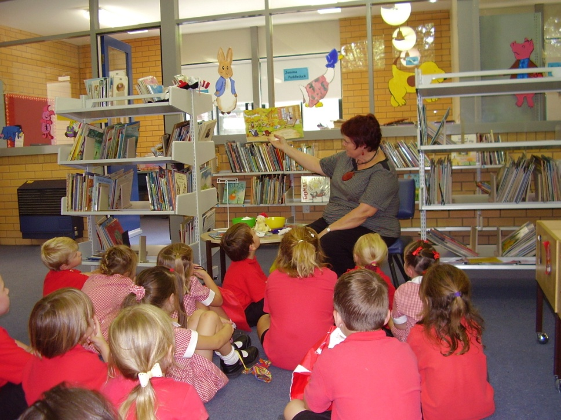
After the story Sarah will sit at a desk and do some work.

Slide 12
When library is finished Sarah will carry her library bag and walk in a line back to the classroom. Mrs Mac will tell Sarah when it is time to go home.

