Slide 1
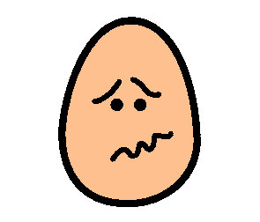
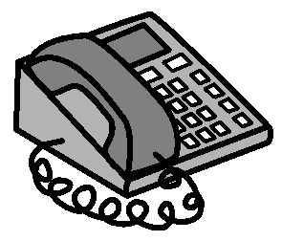
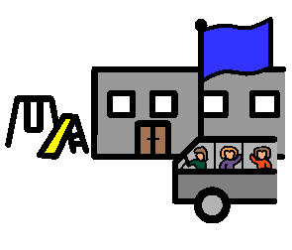
My name is Molly
Rose
My mum’s name is Mary.
Mobile number
987 6543
I am 13 years old and have Down Syndrome.
I often wander away from my parents.
My dad’s name is Luke.
Mobile number
987 6543
You need to contact my mum or dad. They will be worried.
I can speak, but you may find it hard to understand me. Encourage me to talk slowly.
Their home phone number is:
123 4567
I attend Gadara School in Tumut. The phone number is 123 4567.

