Slide 1
Eddy will be gentle with his computer.

Slide 2
Eddy cannot hit the computer. If Eddy hits the computer it will break.

Slide 3
Eddy cannot hit the mouse. If Eddy hits the mouse it will break.

Slide 4
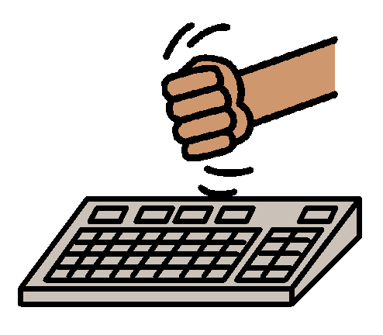
Eddy cannot hit the keyboard. If Eddy hits the keyboard it will break.

Slide 5
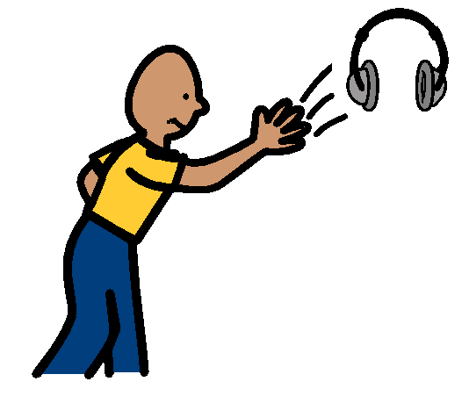
Please do not throw the earphones. If Eddy throws the earphones they will break.

Slide 6
Please be nice to Eddy’s computer. If Eddy breaks his computer he will not be able to watch Spirit.

