Slide 1
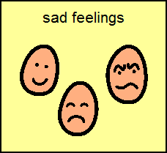
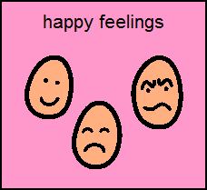
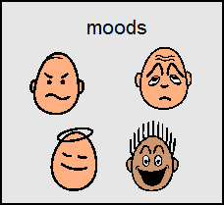
sad
depressed
embarrassed
angry
shocked
disappointed
hurt
confused
frustrated
stupid
excited
happy
accepted
pleased
content
curious
love
accepted
and happy
lazy
ready to work
tired
angry
friendly
cooperative
grumpy
not friendly

