Slide 1
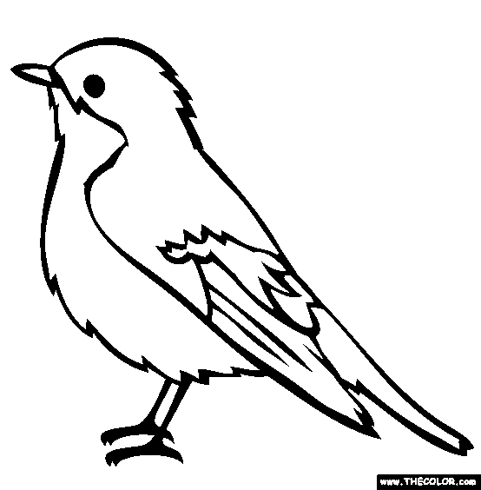

Slide 2
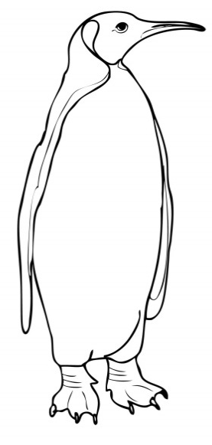
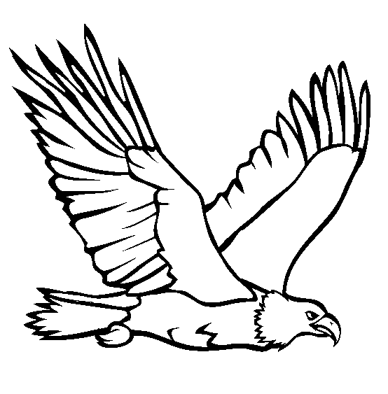
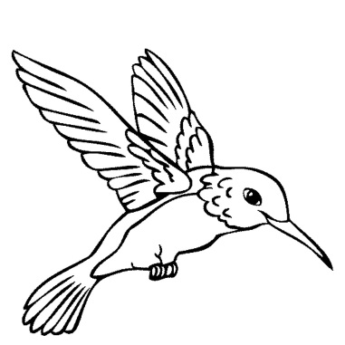
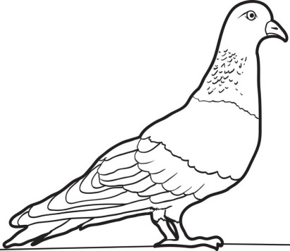
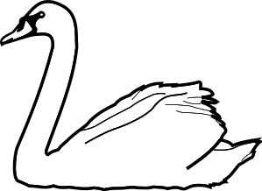
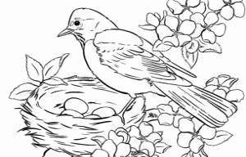
Bird Labelling

Slide 3
eagle
wing
swan
pigeon
egg
nest
penguin
beak
feather
hummingbird
wing
feet
legs
beak
tail
head

Slide 4
Birds live in
Birds eat
Birds move by
Birds find mates by

Slide 5
forests
fruit
flying
wetlands
meat
running
desert
seeds
swimming
cities
insects
crawling

Slide 6
using bright feathers
singing
dancing
building a nest

Slide 7
What do birds look like?
1
2
3
4
5
6

Slide 8
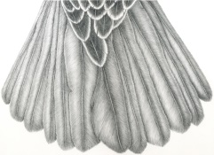
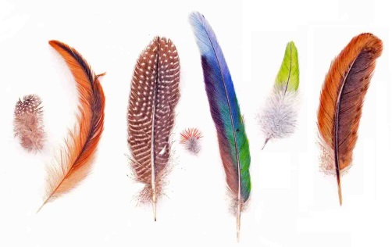
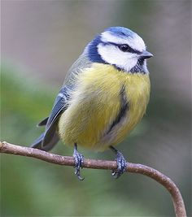
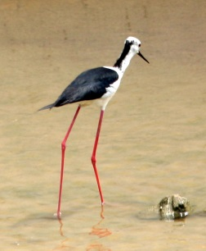
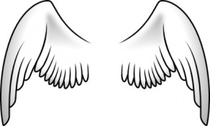
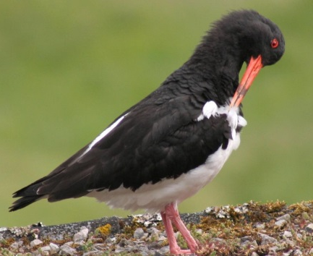
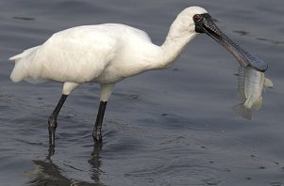
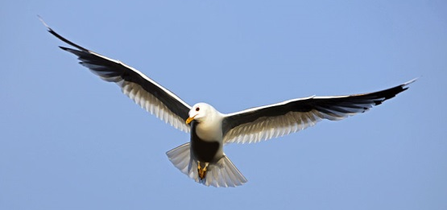
What do birds look like?
A bird has 2 wings and a tail.
All birds have feathers on their bodies.
Birds have 2 legs and 2 feet, though they may be long or short.
tail
2 wings
Birds do not have teeth. They use their bills or beaks to eat.
Most birds use their wings to fly. They steer with their tails.
Birds preen their feathers. This is how they clean themselves.

Slide 9
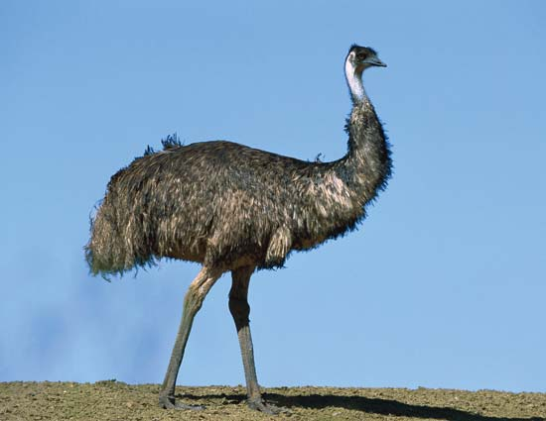
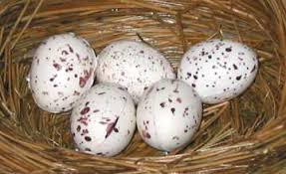
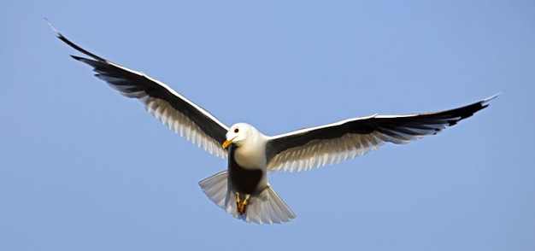
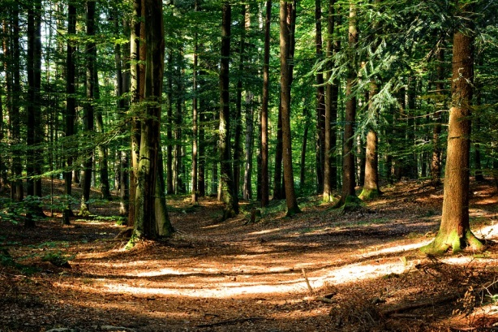
Feathers and Wings, Beaks and Bills
fly
lay eggs
emu
wings
feathers
forest

Slide 10
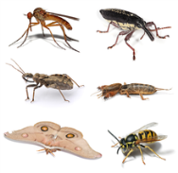
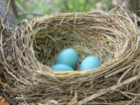
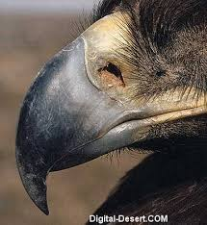
feathers
insects
fly
eggs
nest
beak

Slide 11
feathers
insects
fly
eggs
nest
beak

Slide 12
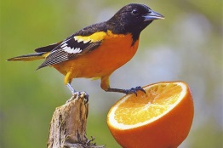
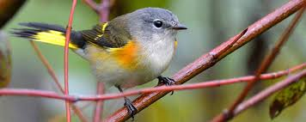
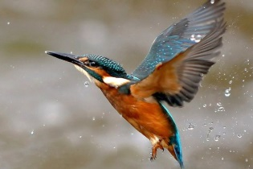
How do birds care for their young?
YES OR NO
All birds lay eggs Yes No
Birds don’t sit on their eggs to help the young grow. Yes No
Birds’ nests are found in many different places. Yes No
4. Only the female sits on the nest. Yes No
5. Baby birds are not hungry. Yes No
6. The birds leave the nest when they can look after themselves. Yes No

