Slide 1
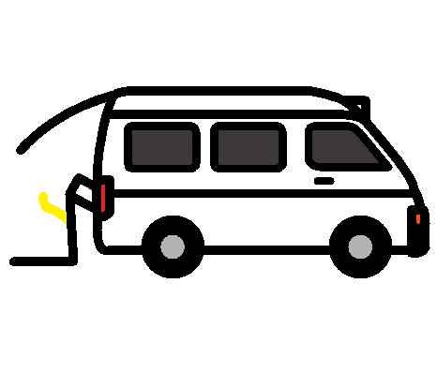
We are going on an excursion in the school bus.
GADARA

Slide 2
We are going to ??.

Slide 3
We are going with ?? .

Slide 4
When we get to ??? we will ??.

Slide 5
We will have recess and lunch at ??.

Slide 6
At the end of ?? we will come back to school.

