Slide 1
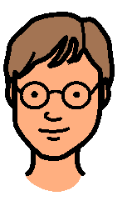
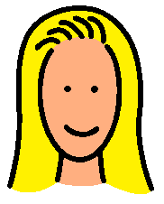
one person
two people
three people
1
2
3
four people
five people
six people
4
5
6

